Slide 1

Review on
Taylor Series
Course : Scientific Computing
Year : 2023

Slide 2

Outlines
Approximations using Taylor Series
Truncation Error for Taylor Series
Estimating Truncation Errors

Slide 3

Expressing Functions
A sequence is an ordered set of numbers denoted by the list of numbers inside parentheses. For example, s = (s1, s2, s3, . . . )
A series is the sum of a sequence up to a certain element. An infinite sequence is a sequence with an infinite number of terms, and an infinite series is the sum of an infinite sequence.
A Taylor series expansion is a representation of a function by an infinite series of polynomials around a point. Mathematically, the Taylor series of a function, f (x), is defined as

Slide 4

Taylor’s Theorem
If the function f and its first n+1 derivatives are continuous on an interval containing a and x, then the value of the function at x is given by:
where the remainder R_{n} is defined as

Slide 5
Maclaurin Series
Letting n grow the Taylor polynomials at x = a define Taylor series at x = a for the respective functions.
Basic Taylor Polynomials yield the following Basic Taylor Series at x = 0.
The Taylor Series at x = 0 are also called Maclaurin series.

Slide 6
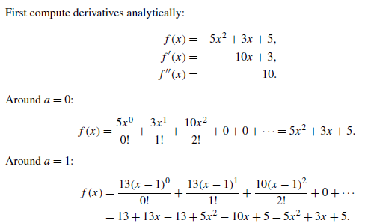
Finding Taylor Series Expansion
Compute a Taylor series expansion for f (x) = 5x²+3x +5 around a = 0, and a = 1. Verify that f and its Taylor series expansions are identical.

Slide 7
Approximating Functions
Another way to get to Taylor Series is to consider approximations of functions by polynomials. assumed that the function f is has derivatives of all orders everywhere in its domain of definition.
Definition
The Taylor polynomial of degree n for given function f at a point a is a polynomial P of degree n such that P^{(k)} (a) = f ^{(k)}(a) for k=0,1,…,n. This means that the value of the polynomial P and all of its derivatives up to the order n agree with those of the function f at the point x=a.
Observe that the defining conditions for the Taylor polynomial have to do with the behavior of the polynomial at one point only.

Slide 8
Approximating Functions
To find the Taylor polynomials of the function f(x) = sin(x) compute derivatives and evaluate them at x = 0. One gets:
All even order derivatives of sin take the value 0 at x = 0. Odd order derivatives take the values 1 and -1.

Slide 9

Review of Taylor Series
The Taylor Polynomials of the function f(x) = (1+x)^{p} are given below. They can be used to approximate the values of the function only for -1<x<1.

Slide 10
Finding Taylor Series by Substitution
Solution

Slide 11
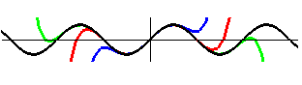
Example: Sine Function
Formula
The following figure illustrates Taylor polynomials of degrees 5 (blue), 9 (red) and 15 (green) for the sine function.
One concludes from the picture that all of the above Taylor approximations for the sine function appear to approximate the function well near the origin (center of the above picture). Higher order Taylor polynomials approximate better away from the origin.

Slide 12
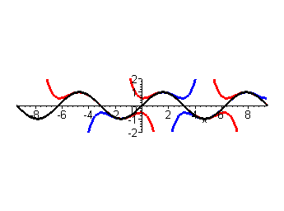
Example: Sine Function
The following figure shows the graph of the sine functions and those of its Taylor polynomials of degree 5 at the points x=-π, x=0, x=π, x=2π, x=3π.
The Taylor polynomial of degree 5 at the point x=-π approximates the sine function so well near the point x=-π that its graphs is completely covered by the black graph of the sine function near that point. As x< -3π/2 or x> -π/2 the approximation fails to follow the graph of the sine function. These portions of the graph of the Taylor polynomial of degree 5 at x=-π are shown as the left most red graphs above and under the x -axis.

Slide 13
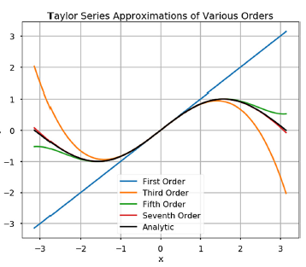
Computational Approximation
Clearly, it is not useful to express functions as infinite sums because we cannot compute them. It is useful to approximate functions by using an Nth order Taylor series approximation of a function
e.g: calculate the Taylor expansion of e_{x} around a = 0, then f (n)(a) = 1 for all n
we do not have to compute all the derivatives in the Taylor expansion to approximate ex !
The seventh order Taylor series approximation is already very close to the theoretical value of the function!

Slide 14



Truncation Error for Taylor Series
In numerical analysis, there are usually two sources of error, round-off and truncation. The truncation errors are usually arisen when using an approximation in place of an exact mathematical procedure.
For example, if we use Taylor series to approximate the function e^{x}
exact mathematical procedure
Four terms approximation
Therefore, the function f (x) can be written as the Taylor series approximation plus a truncation error term

Slide 15



Estimating Truncation Errors
Using the Taylor series, if we use only the first n terms, we can see that
We can estimate the truncation error E_{n}(x) using the Taylor Remainder Estimation Theorem, which states:
If the function f(x) has n+1 derivatives for all x in an interval I containing a, then for each x in I there exists a z between x and a such that :
If we know that M is the maximum value of |f (n+1)| in the interval, then we obtain

Slide 16
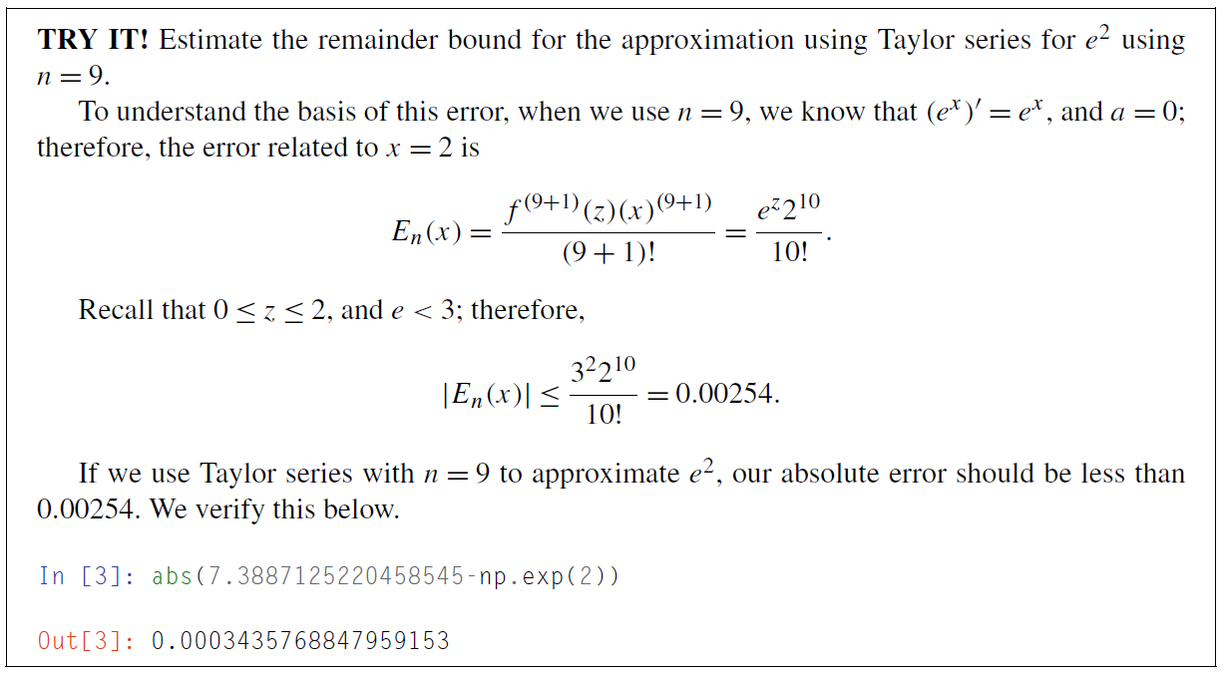
Example

Slide 17
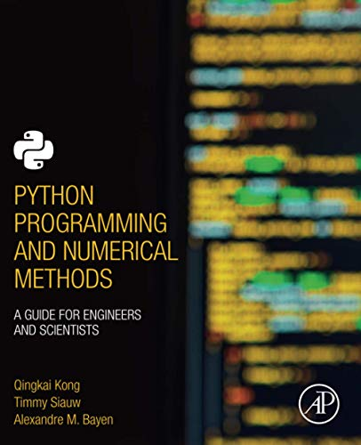
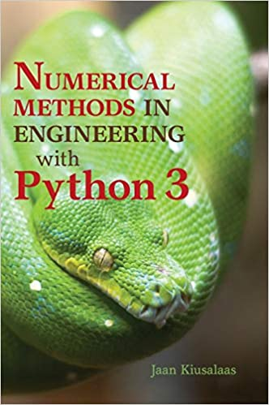
Acknowledgement
These slides have been adapted from: Kong, Q., Siauw, T., & Bayen, A. M. (2021). Python Programming and Numerical Methods: A Guide for Engineers and Scientists. Academic Press. ISBN: 978-0-12-819549-9 Kiusalaas, J. (2013). Numerical Methods in Engineering with Python 3. United Kingdom: Cambridge University Press. ISBN:9781107033856 Additional materials : Chapra, S.C (2015). Numerical Methods for Engineers. 6st Edition. McGraw-Hill Companies, Inc . New York. ISBN. 978-981-4670-87

